Slide 1
Drawing Conclusions:
How Education Impacts Income Across the United States
Group 6: Aminah Qandeel, Caleb Steeves, Amy Baker, Kudirat Abdulsalam, Lexie Fallow

Slide 2
Research Questions and Data Sources
Research Questions:
What is the correlation between education levels (higher education vs. no higher education) and income?
Which degree type (associate’s or bachelor’s degrees) has the greatest impact on income?
Which region in the United States has the highest concentration of individuals with higher education degrees, and is this region also associated with the highest income level?
Data Sources:
Kaggle: Per Capita Income by County (2021) vs. Education (main data source)
U.S. Bureau of Economic Analysis
U.S. Department of Agriculture (USDA)
World Population Review: Cost of Living Index by State
Geoapify API Data

Slide 3

Data Exploration and Cleanup
Import dependencies and CSV files
Converted full state name to abbreviated state name to allow us to merge our CSVs
Merged the two datasets
Remove unnecessary columns
Create a metric for adjusted Income
Income / (cost of living index / 100)
Remove outliers

Slide 4
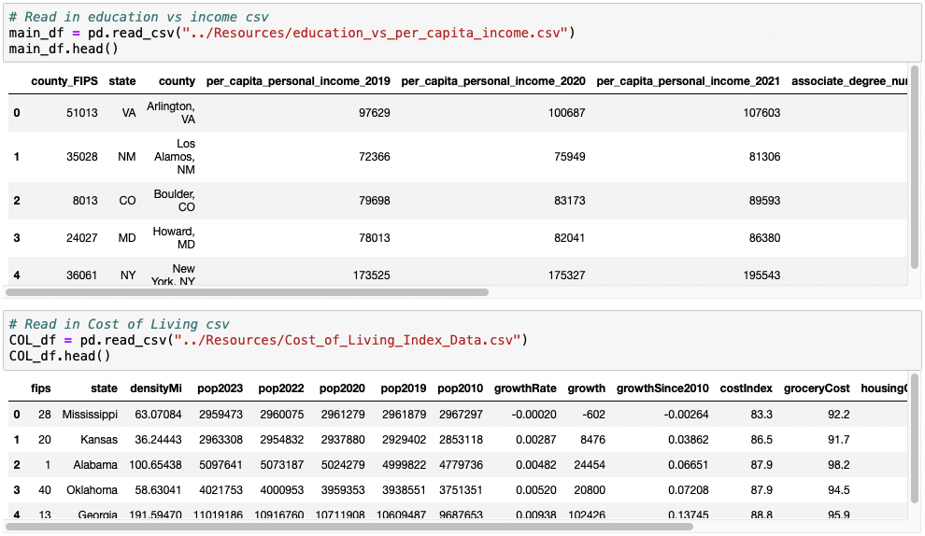
Read in Data Sets
Notice that the state columns in the two data sets don't match

Slide 5

Merging
Used a dictionary to replace all of the full state names with their corresponding abbreviations.
We then merge our two data sets on the ‘state’ column.

Slide 6

Creating Columns and Final DF
Needed to account for cost of living inflations in Per Capita Personal Income.
Final Data Frame only has columns we will be using in our analysis.

Slide 7
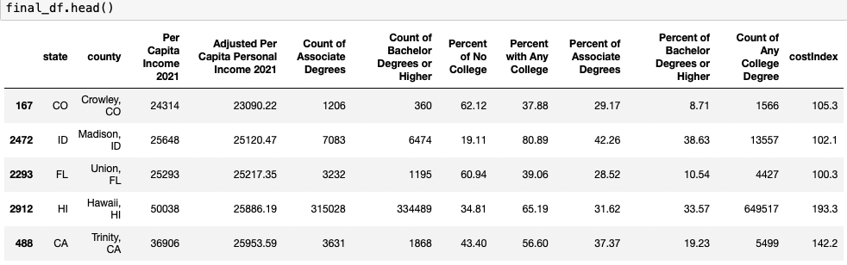
Final Data Frames

Slide 8
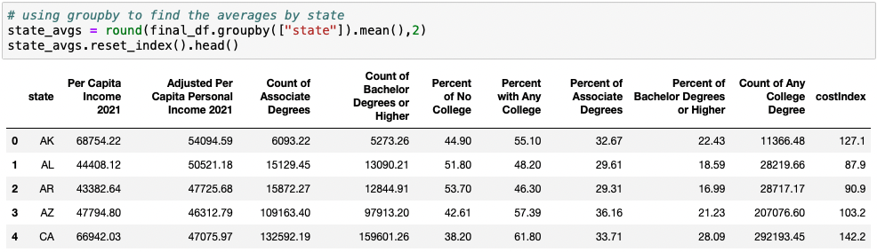
Grouping Counties by State

Slide 9

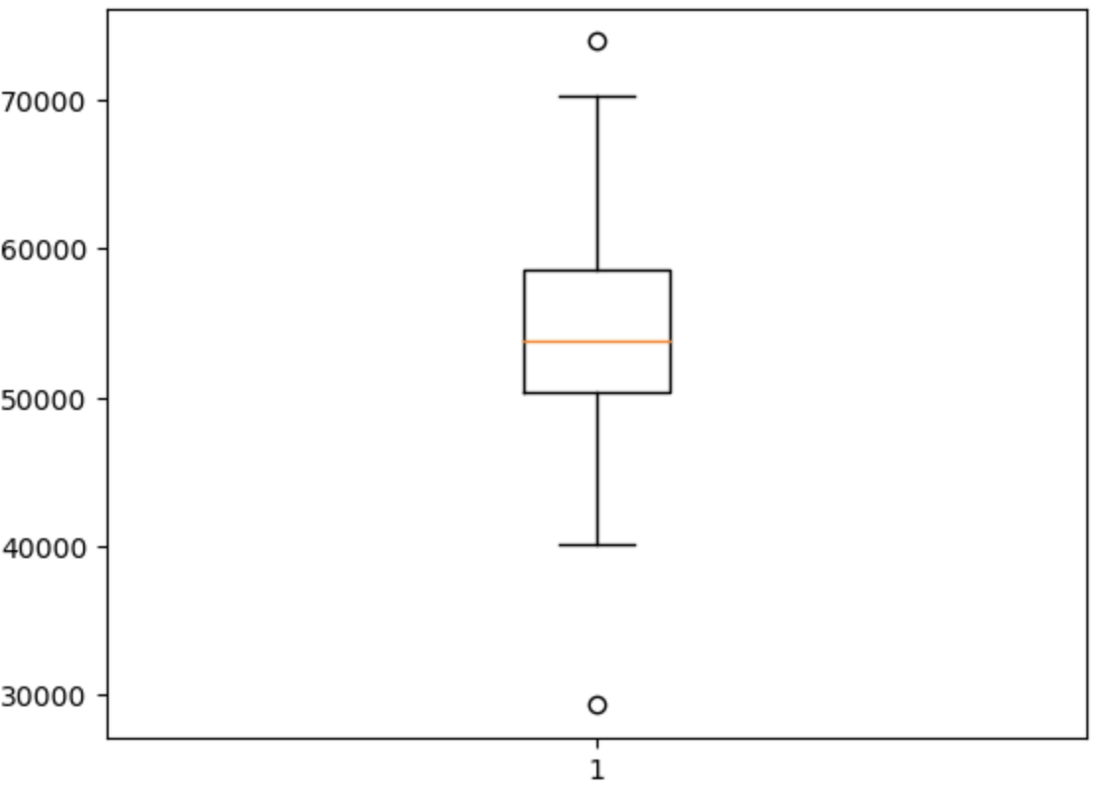
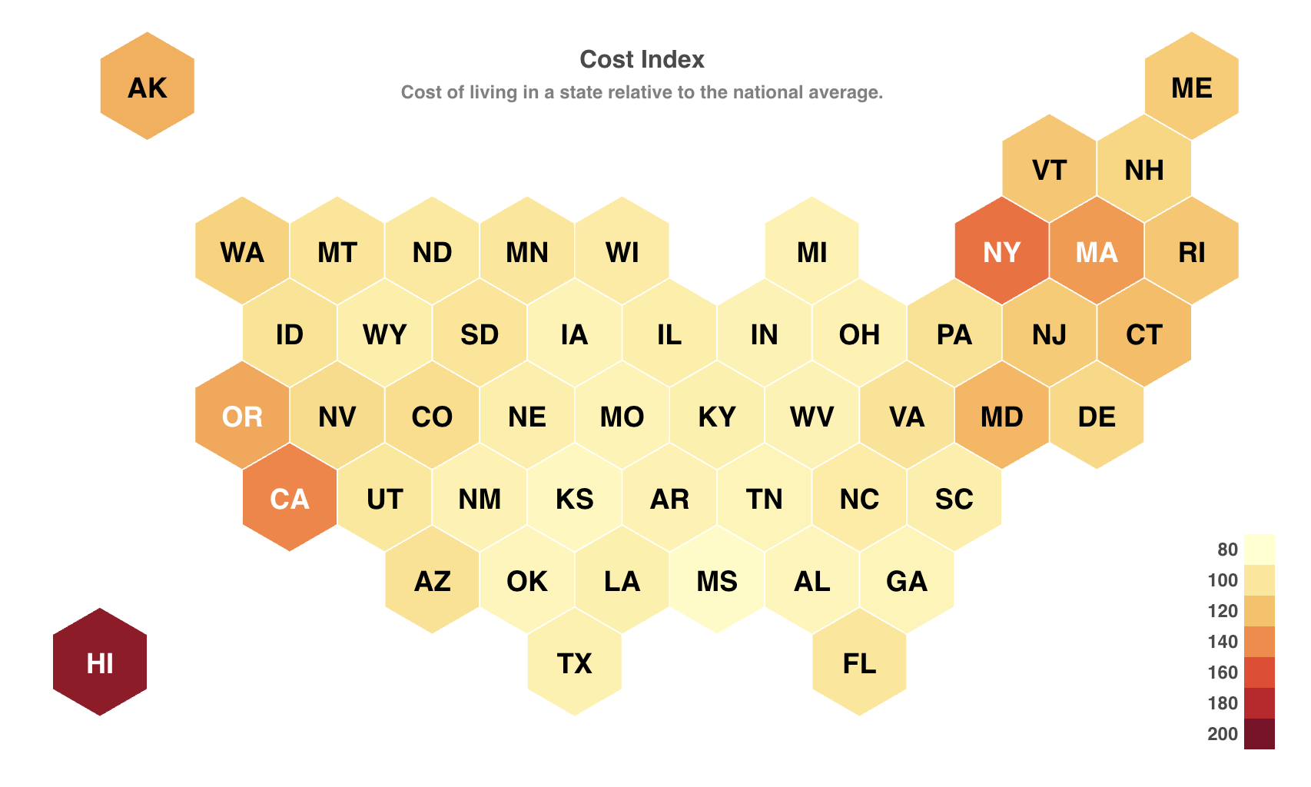
Checking for Outliers
Average adjusted per capita personal income is $54,000 annually
removed outliers: $73,922 (WY) and $29,324 (HI)

Slide 10

Analysis and Visualizations

Slide 11
Which degree type (associate’s or bachelor’s degrees) has the greatest impact on income?

Slide 12
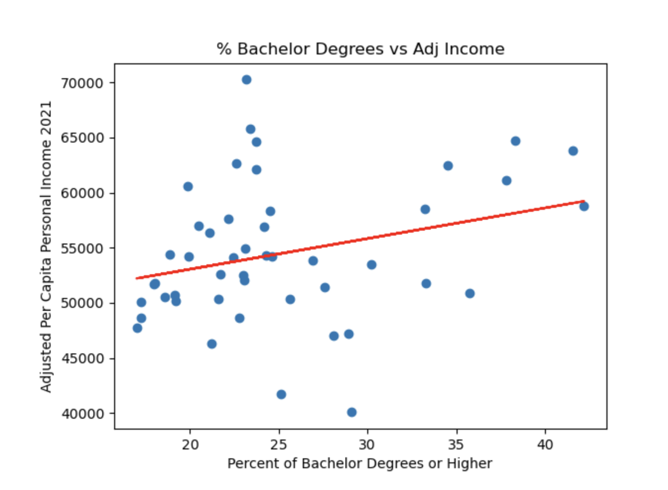
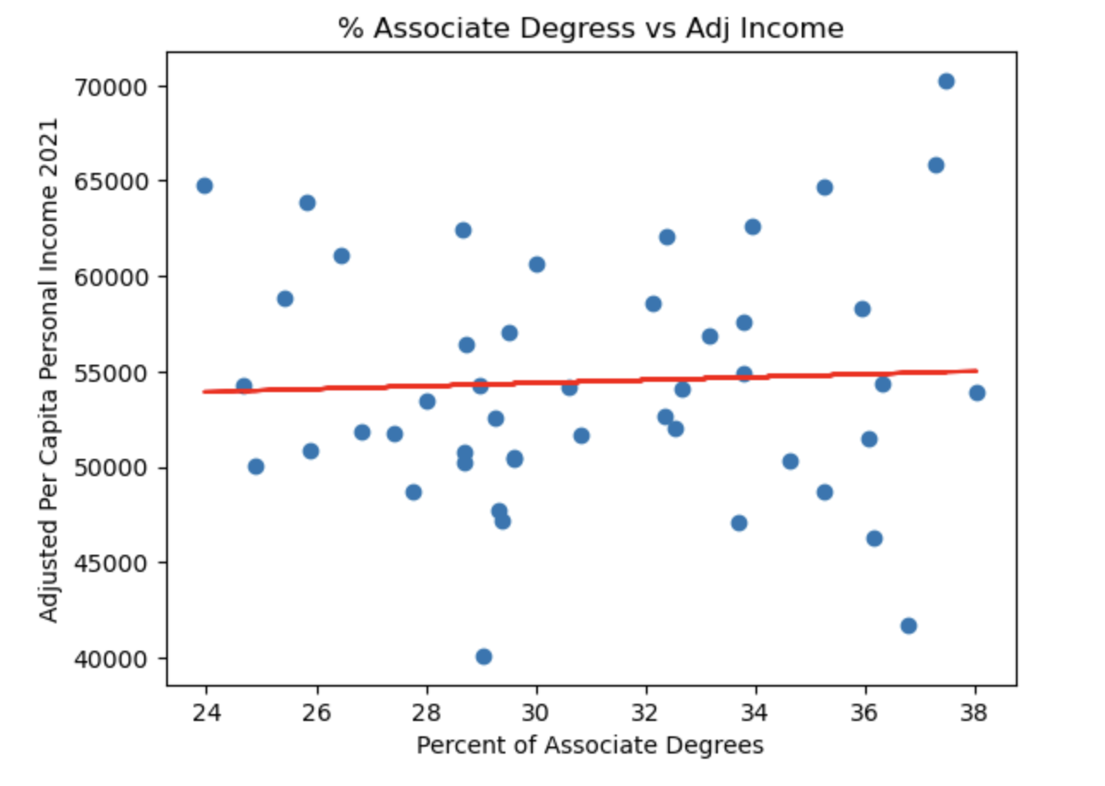
Percentage of Associate’s and Bachelor’s Degrees vs Adjusted Income
Weak positive correlation between percentage of bachelor degrees and adjusted income. R-value is 0.28510351732101147
Negligible correlation between percentage of associate degrees and adjusted income. R-value is 0.04758890652182892

Slide 13
What is the correlation between education levels (higher education vs. no higher education) and income?

Slide 14
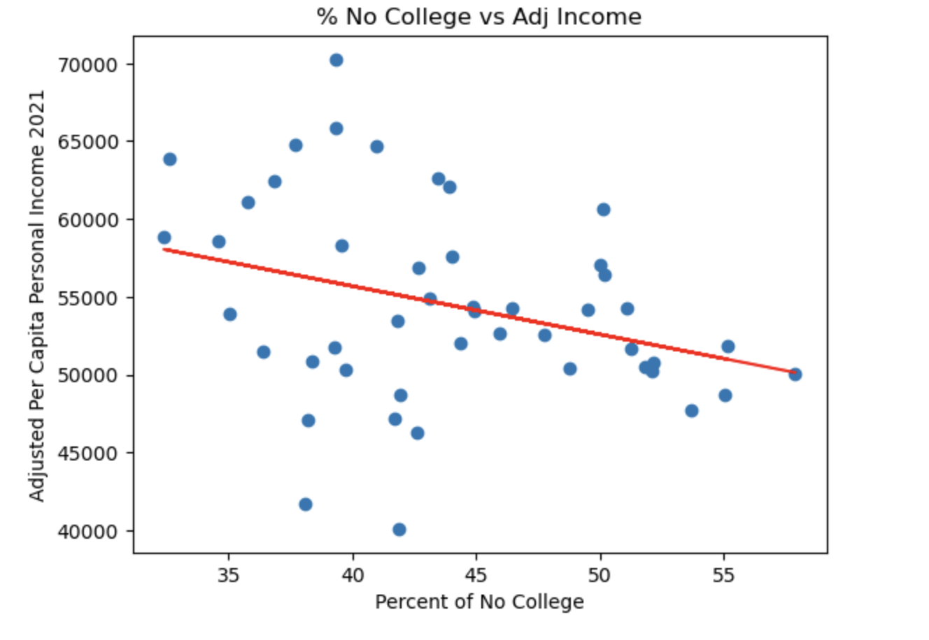
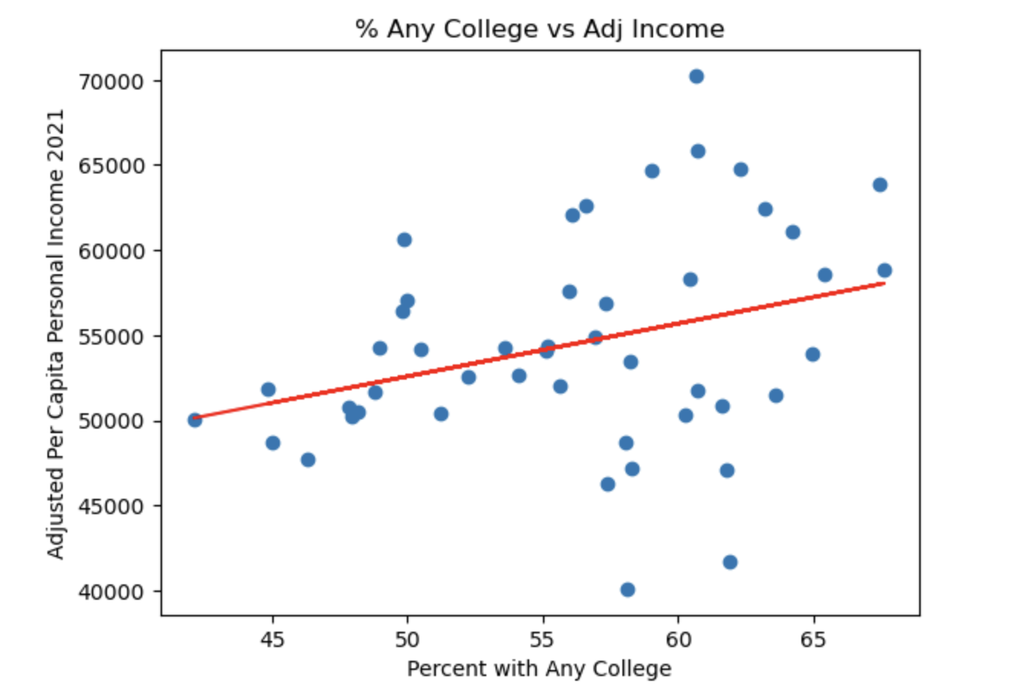
Adjusted Incomes for Percentage of Population Without College and Percentage of Population With Any College
Relationship between having no degree and a higher income has a weak and negative correlation.
As the percentage of people without degrees increases, the income slightly decreases, but the relationship is too weak to draw a conclusive argument.
R-Value is -031613283638902323

Slide 15
Which region in the United States has the highest concentration of individuals with higher education degrees, and is this region also associated with the highest income level?

Slide 16
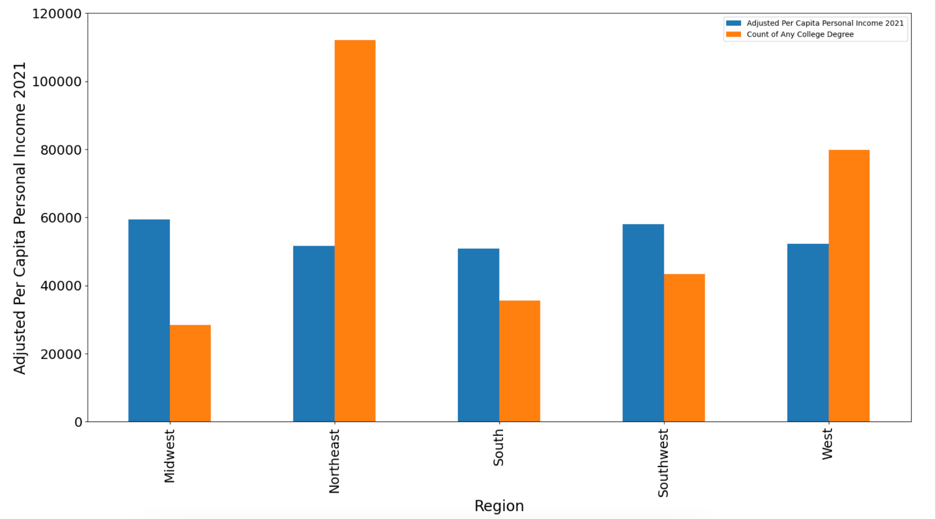
College Degrees and Adjusted Income by Region

Slide 17
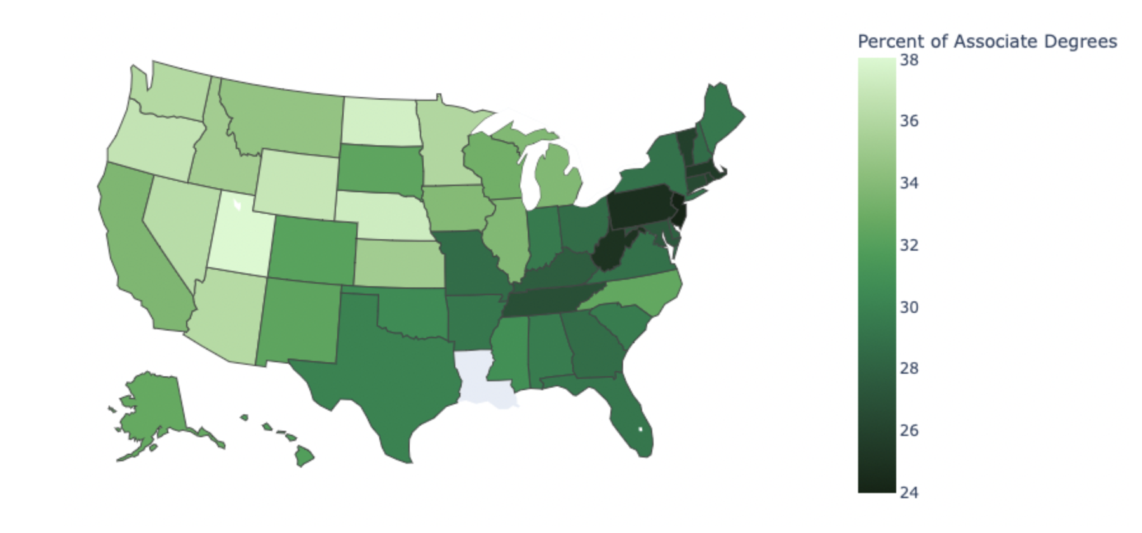
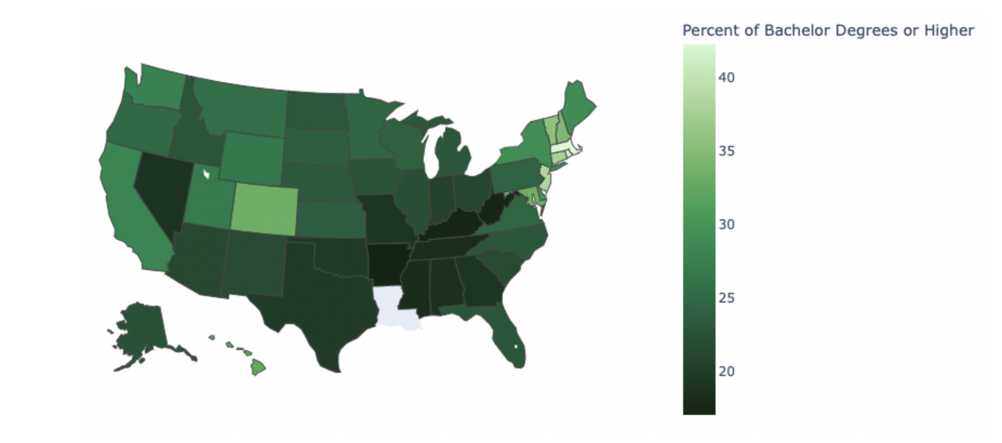
Percentage of Associate’s and Bachelor’s Degrees by State
Associate’s degrees are more popular in the western part of the United States than the eastern side.
The East Coast states have the highest percentages of bachelor’s degrees in the country

Slide 18
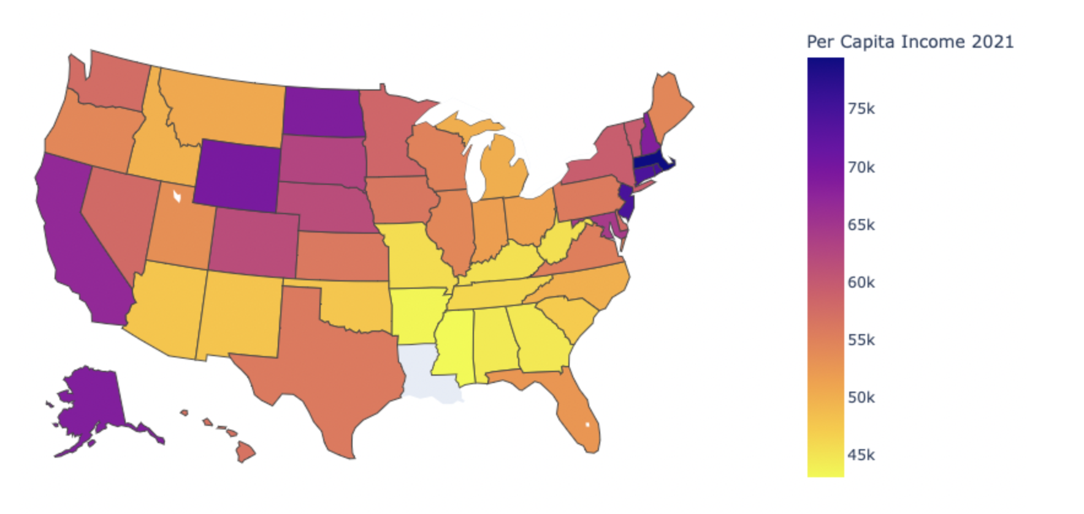
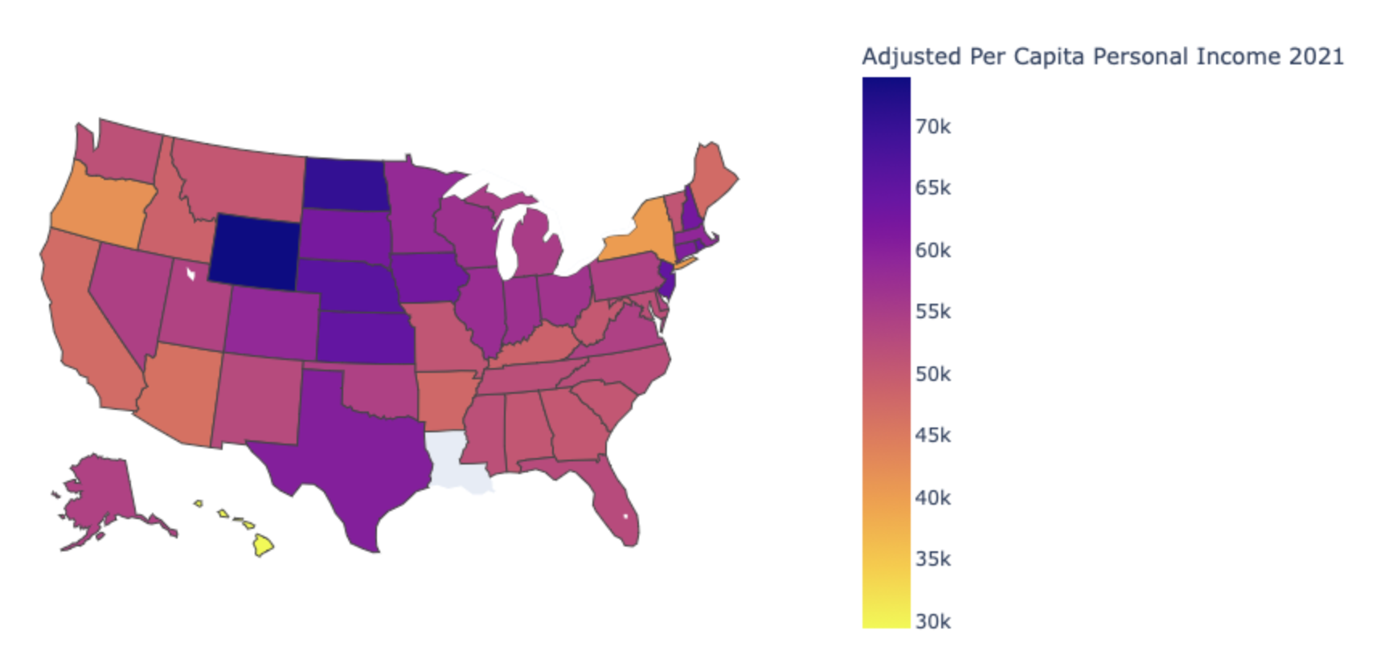
Adjusted Per Capita Personal Income vs Per Capita Personal Income
In the Per Capita Income map, a few states stand out as having higher incomes: North Dakota, Wyoming, California and Hawaii.
In the Adjusted Per Capita Personal income map, Wyoming has the highest adjusted per capita personal income.

Slide 19
Conclusions & Implications
What is the correlation between education levels (higher education vs. no higher education) and income?
Any amount of college positively correlates to a higher income, but between the two degrees, bachelor’s degree and higher college degrees tend to yield a higher income.
What degree type (associate’s or bachelor’s degree) has the greatest impact on income?
The scatter plot results advise that a bachelor’s degree has a greater impact on income compared to the associates degree.
Which region in the United States has the highest concentration of individuals with higher education degrees, and is this region also associated with the highest income level?
Based on the bar graph findings, the Northeast region has the highest concentration of individuals with higher education degrees, but this does not yield the highest income.

